Slide 1
Bias & Variance in Machine Learning

Slide 2
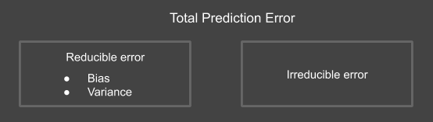
Total Prediction error
Error(Model) = Variance(Model) + Bias(Model) + Variance(Irreducible Error)

Slide 3
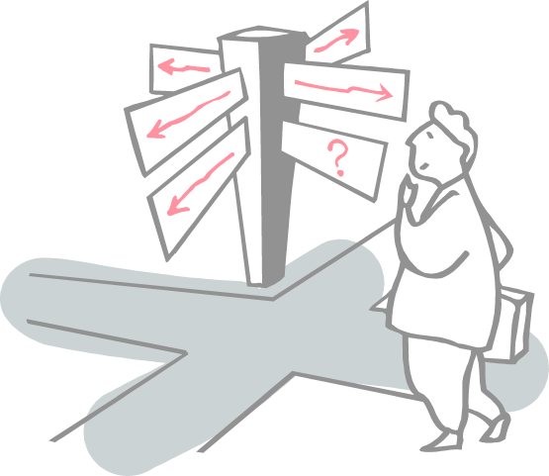
Roadmap
What is bias?
What is variance?
Understanding the tradeoff

Slide 4
Bias
The bias is a measure of how close the model can capture the mapping function between inputs and outputs.
It captures the rigidity of the model: the strength of the assumption the model has about the functional form of the mapping between inputs and outputs.
Low Bias is desired : High Bias means UnderFitting of the model on training data.
Low Bias : Suggests less assumptions about the relation in data to predict the target function. Example: SVM, Decision Tree, KNN
High-Bias : Suggests more assumptions about the relation in data to predict the target function. Example: Linear Regression, Logistic Regression

Slide 5
Variance
Variance is the amount that the estimate of the target function will change if different training data was used.
The variance of the learning method, how much the learning method will move around its mean.
Low Variance is desired : High Variance means OverFitting of the model on training data.
Model with high variance pays a lot of attention to training data and fail to generalize on the unseen data. As a result, such models perform very well on training data but has high prediction error on unseen/test data
Low Variance: Small changes to the estimate of the target function with changes to the training dataset. Example: Linear Regression, Logistic Regression
High Variance: Large changes to the estimate of the target function with changes to the training dataset.Example: SVM, Decision Tree, KNN

Slide 6
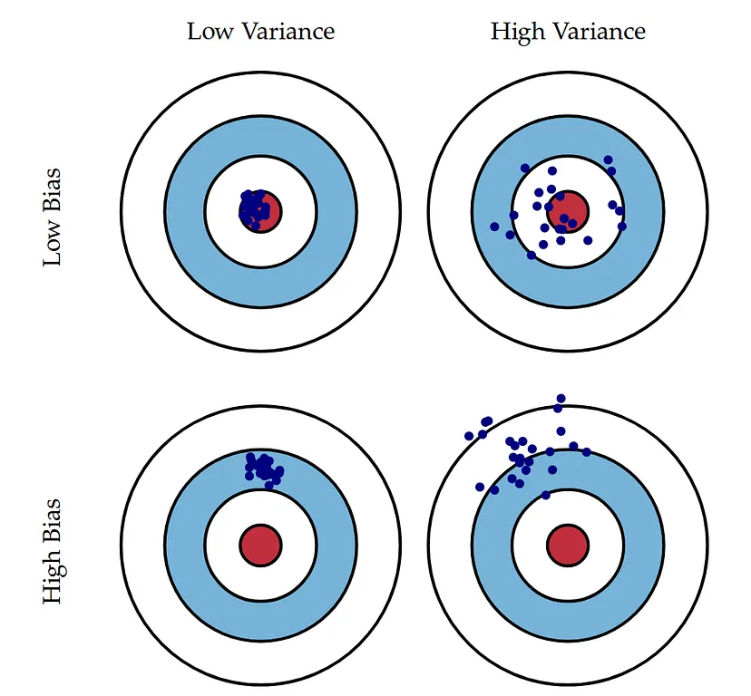
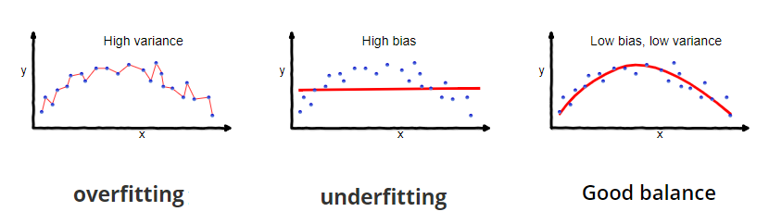
Bias-Variance Trade-Off
Ultimate goal of any machine learning algorithm is to build a prediction model with Low Bias and Low Variance that is measure of reduced error and correct prediction power of any model.

Slide 7
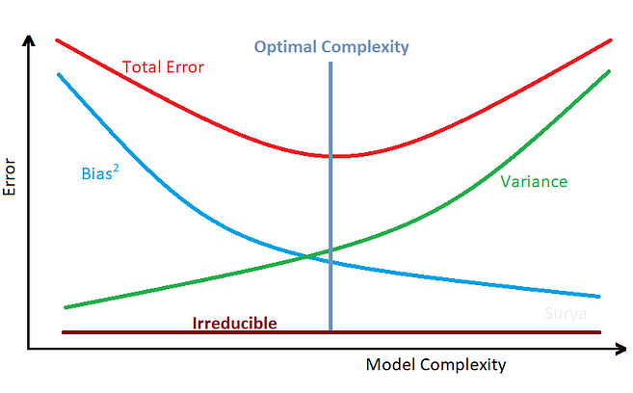
Bias-Variance Trade-Off
Decreasing the Variance will increase the Bias
Decreasing the Bias will increase the Variance
We need to have optimal model complexity (Sweet spot) between Bias and Variance which would never Underfit or Overfit.

Slide 8
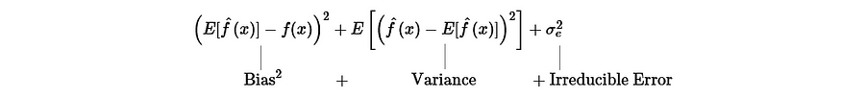
How are Bias, Variance and Irreducible Errors are related?
Error = Reducible Error + Irreducible Error
Reducible Error is the sum of squared Bias and Variance. Reducible Error = Bias² + Variance
Combining the above two equations, we get
Error = Bias² + Variance + Irreducible Error

Slide 9
Bias-Variance Trade-Off
Lowering high Bias or Underfitting:
Use non Parameterised Algorithms
Make model more complex with more features
Use Non Linear Algorithms Example( Polynomial Regression, Kernel Function in SVM
Lowering high Variance or Overfitting:
Use More Data for training to make model learn maximum hidden pattern from the training data and model becomes generalised
Use Regularization Techniques
Hyper Parameter Tuning to avoid Overfitting
Use less number of features
Reduce complexity of Model
Parametric or linear machine learning algorithms often have a high bias but a low variance.
Non-parametric or non-linear machine learning algorithms often have low bias but high variance.

Slide 10
References
https://medium.com/edureka/cross-validation-in-machine-learning-d629dec3f497
https://machine-learning-tutorial-abi.readthedocs.io/en/latest/content/overview/crossvalidation.html
https://www.cs.cmu.edu/~schneide/tut5/node42.html#:~:text=The%20holdout%20method%20is%20the,using%20the%20training%20set%20only.

Slide 11
Thanks

